Slide 1
Building Microservices with Spring Cloud/Netflix OSS
NIDC Belfast
9th June 2018
nidevconf.com

Slide 2
About…
Udhayakumar Rajendran
Senior Software Developer @ Camlin Technologies, Lisburn
https://github.com/udhayapps/
https://www.linkedin.com/in/udhayakumar-rajendran/

Slide 3
Agenda
Microservices – The Basics
Use Case
Spring Cloud + Netflix OSS
Configuration
Service Discovery
Load Balancing
Circuit Breaker
Gateway/Routing
Logging/Tracing
Sidecar
Demo
Q&A

Slide 4
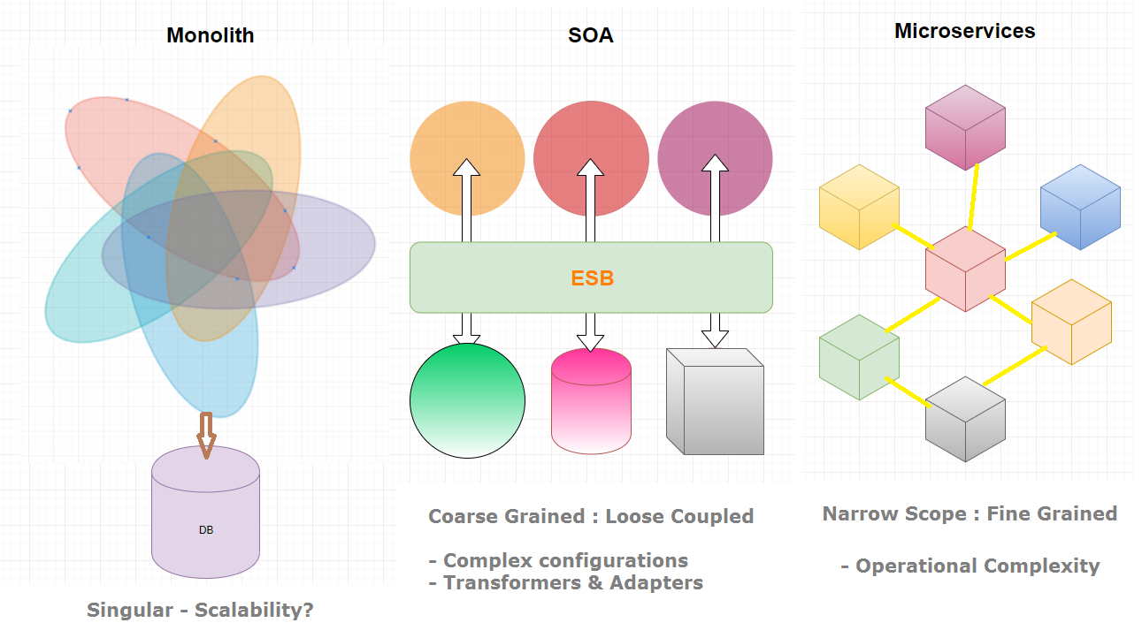
Evolution to Microservices
Decoupled

Slide 5
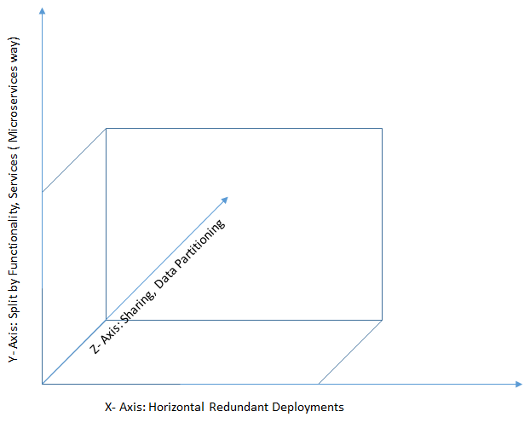
Scale Cube
Source: Scale Cube by Martin L. Abbott and Michael T. Fisher

Slide 6
Microservice – The Definition
The microservice architectural style is an approach to developing a single application as a suite of small services, each running in its own process and communicating with lightweight mechanisms, often an HTTP resource API. These services are built around business capabilities and independently deployable by fully automated deployment machinery. There is a bare minimum of centralized management of these services, which may be written in different programming language and use different data storage technologies.
James Lewis & Martin Fowler
https://martinfowler.com/articles/microservices.html

Slide 7
Microservice – The Definition
“
Loosely coupled SOA with bounded context
"fine grain SOA". So microservices is SOA with emphasis on small ephemeral components
- Adrian Cockcroft
1:16 AM - 11 Dec 2014
https://twitter.com/adrianco/status/542850261782237184
”

Slide 8
Microservices – Pros & Cons
Pros ☺
Stateless & Disposable
Fine grained
- Decoupled services
Autonomous
- Highly independent
Scalable
Resilient
- Fault isolation
Fast deployment
- CI Build and Release
Technology Diversity
Cons ☹
Operational complexity
- DevOps heavy
Inherent complexity of distributed systems
Transaction management and data modelling is tough
Cost of server sprawl
Testing
Conway’s Law
organizations which design systems ...are constrained to produce designs which are copies of the communication structures of these organizations
Notes:
Regression testing, PACT testing, organizations which design systems ... are constrained to produce designs which are copies of the communication structures of these organizations

Slide 9



Slide 10
Spring Cloud?
Tools to develop common patterns for distributed systems.
Defaults to build Cloud Native apps with ease via Spring Boot.
Implement boiler plate patterns that would work in any environment – Cloud Agnostic + Dev

Slide 11
Spring Cloud Netflix OSS
Component | Netflix / Spring / Others…
Configuration Server | Spring Cloud Config Server/ Consul / Vault
Service Registration & Discovery Server | Netflix Eureka / Zookeeper / Consul
Load Balancer | Netflix Ribbon
Circuit Breaker | Netflix Hystrix
Gateway (Edge Server) | Netflix Zuul / Spring Cloud Gateway
Logging/Tracing | Spring Cloud Sleuth / Zipkin / ELK
Messaging + Event Driven | Spring Cloud Stream
Security | Spring Cloud Security (JWT, OAuth 2)
Polyglot | Netflix Sidecar

Slide 12
Use Case: Insurance

Slide 13
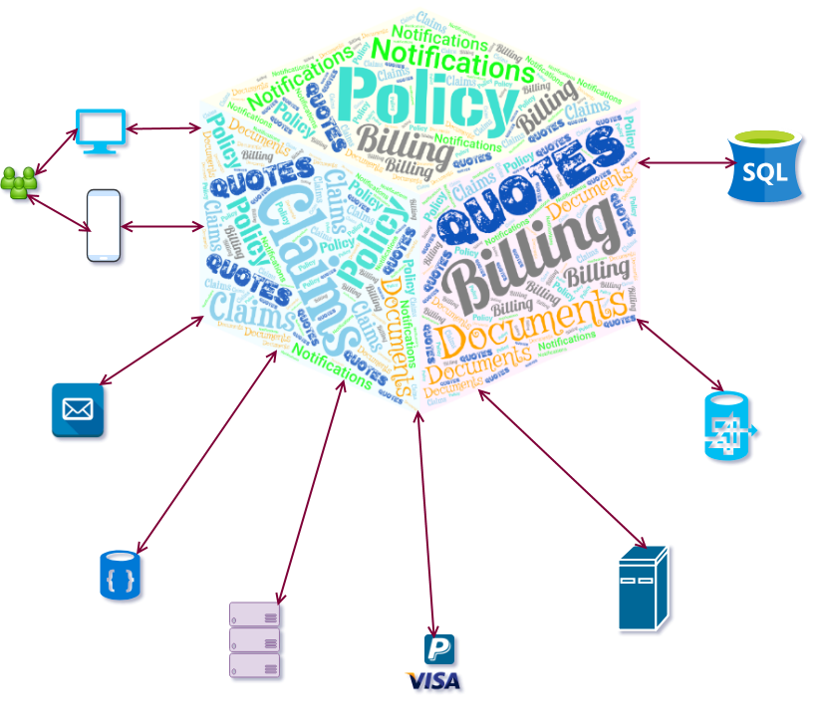
Monolith

Slide 14
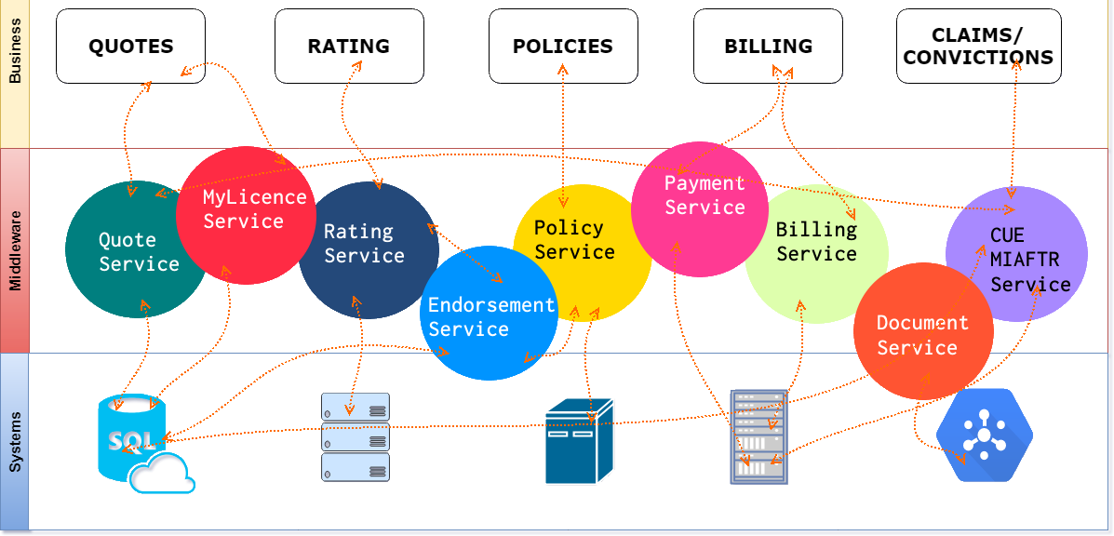
SOA

Slide 15
Microservices
Quote
Policy
Rating
Billing
Claims
Telematics
Endorsement

Slide 16
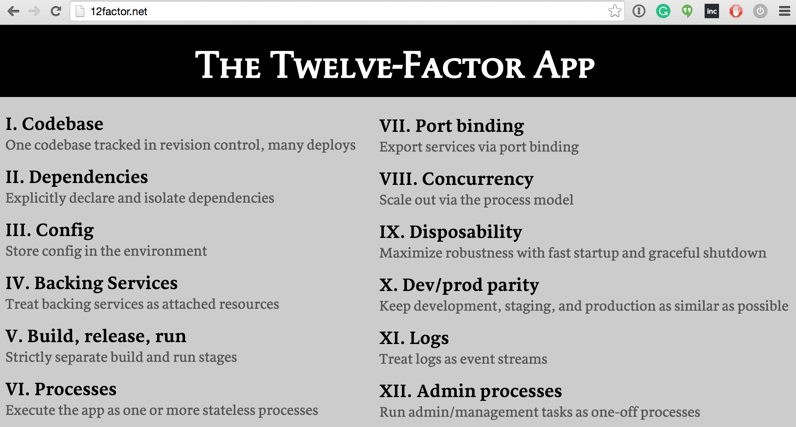
Source: © 12factor.net / Adam Wiggins / Heroku

Slide 17
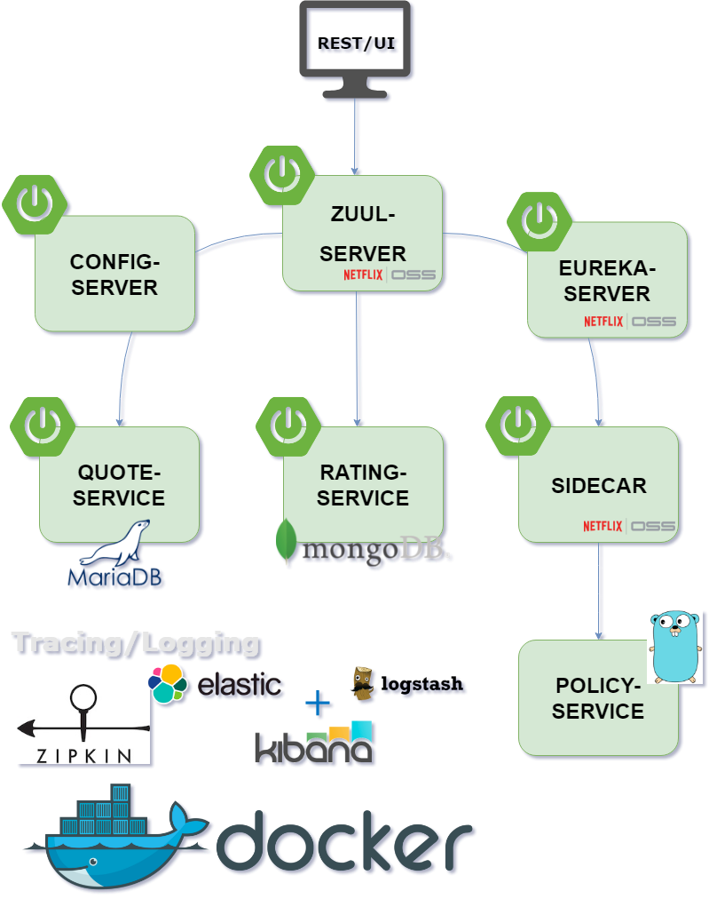

Slide 18
Spring Cloud Config
Centralized store – accessible across microservices
Integration – Git, SVN, Consul/Vault, Filesystem
Microservices retrieve configuration details from Config Server on start-up
Change notification
@RefreshScope
Spring Cloud Bus

Slide 19
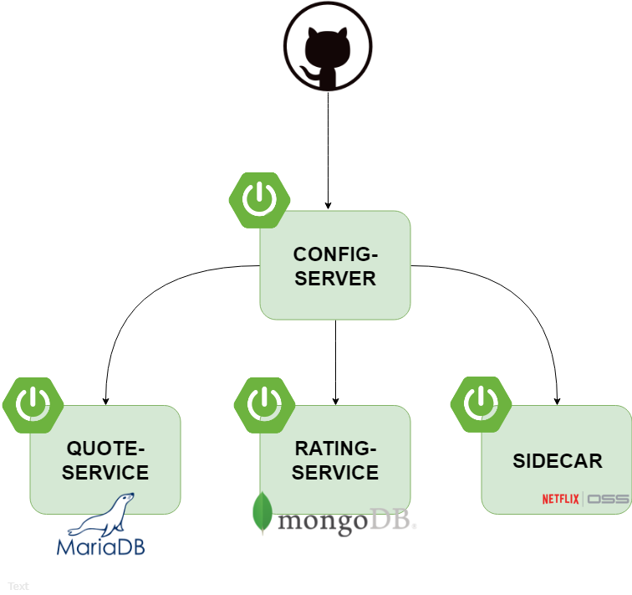

Slide 20

Spring Cloud Config
Protect sensitive config properties with Symmetric/Asymmetric Encryption or even better use Vault service
Microservice Clients do not stop on bootup if Config Server is down
spring.cloud.config.failFast = true

Slide 21
Service Discovery – Netflix Eureka
Enables microservices to discover each other
Abstracts physical location of services
Service Discovery – Server & Client
Client Heartbeats (30 sec) – to renew lease with server
Client side load balancing provided by Netflix Ribbon

Slide 22
Service Discovery – Netflix Eureka
To invoke services (Inter Service Communication):
Service Discovery Client
Netflix Feign/OpenFeign Client
Spring 5 Reactive WebClient
Alternatives:
Zookeeper, Consul

Slide 23
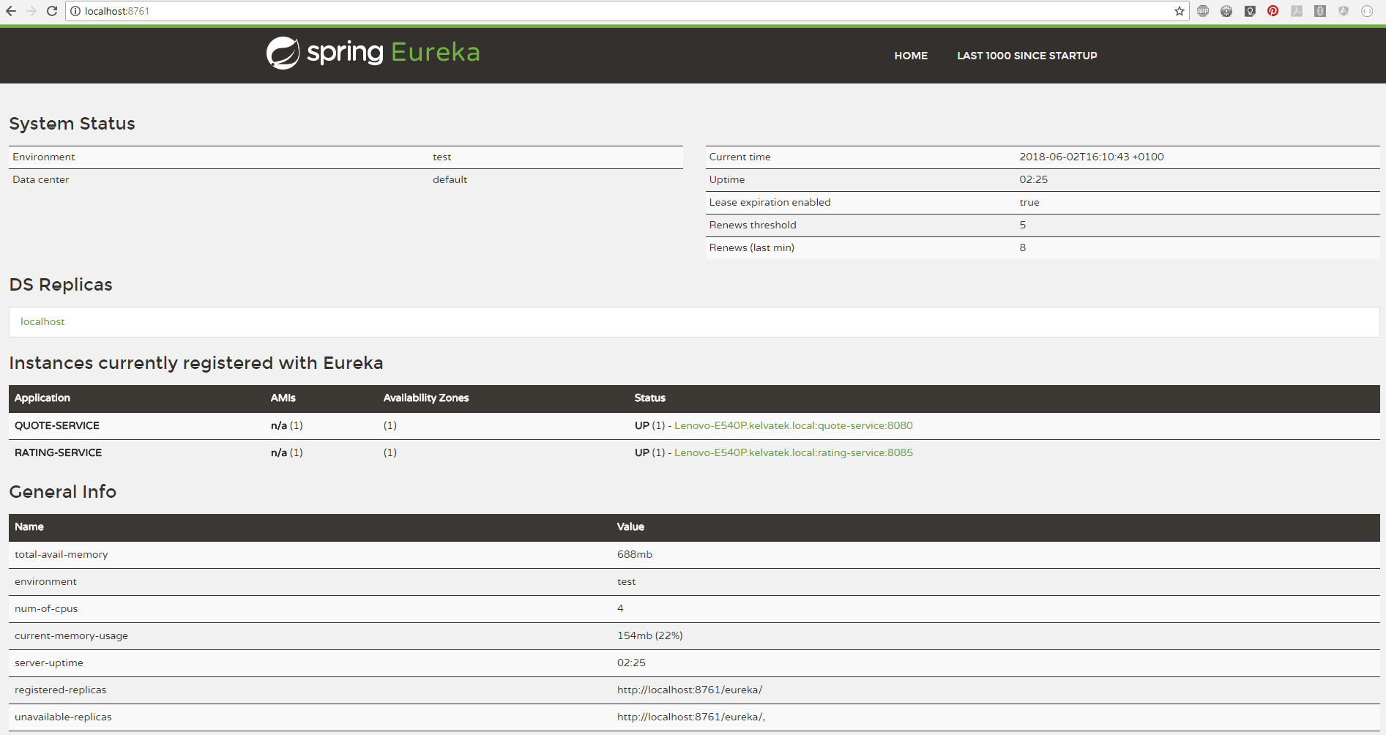

Slide 24
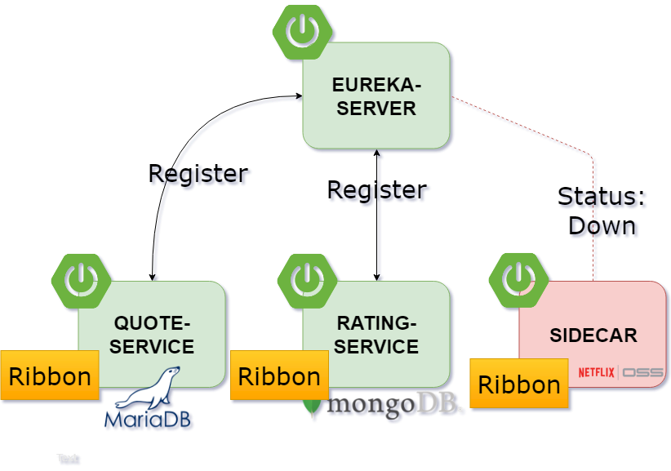

Slide 25
Load Balancing - Netflix Ribbon
Ribbon is a client side IPC library
Service Discovery Integratrion
Load Balancing (RoundRobinRule, AvailabilityFilteringRule, WeightedResponseTimeRule)
Fault Tolerance
Caching- with Hystrix support
Ribbon doesn’t call Eureka every time it makes a call. It caches the location of the service instances locally and checks periodically.

Slide 26
Resiliency
Fail-fast
- Prevent the effect of cascading failures reaching upstream
Core Resiliency Patterns
Circuit Breaker
Fallback
Bulkhead

Slide 27

Netflix Hystrix
Resilient/Fault Tolerant library

Slide 28
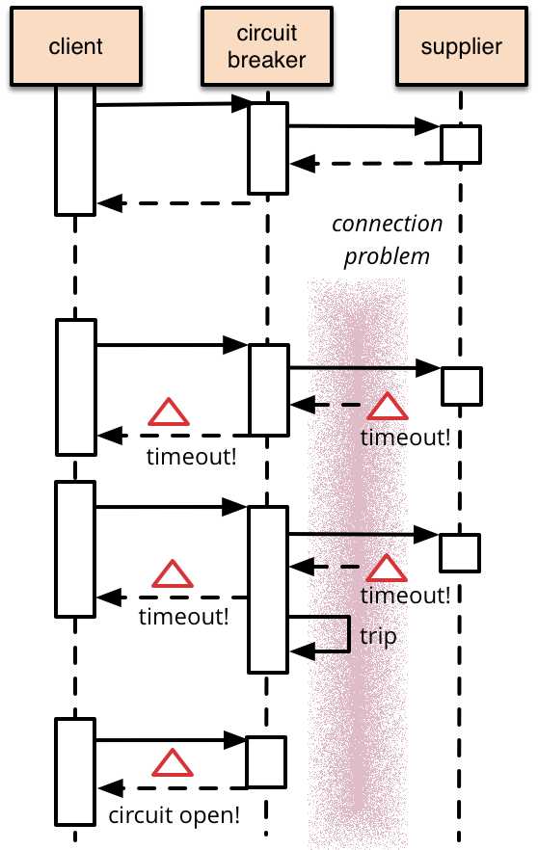
Circuit Breakers – Netflix Hystrix
Source: https://martinfowler.com/bliki/CircuitBreaker.html

Slide 29
Circuit Breakers – Netflix Hystrix
@EnableCircuitBreaker on Spring Boot app
@HystrixCommand
1000 millisecond default timeout
Modify timeout and other properties via @HystrixProperty
Fallback processing
@HystrixCommand(fallbackMethod = “fallbackMethodName”)
Thread Context
Isolation Models – THREAD and SEMAPHORE

Slide 30
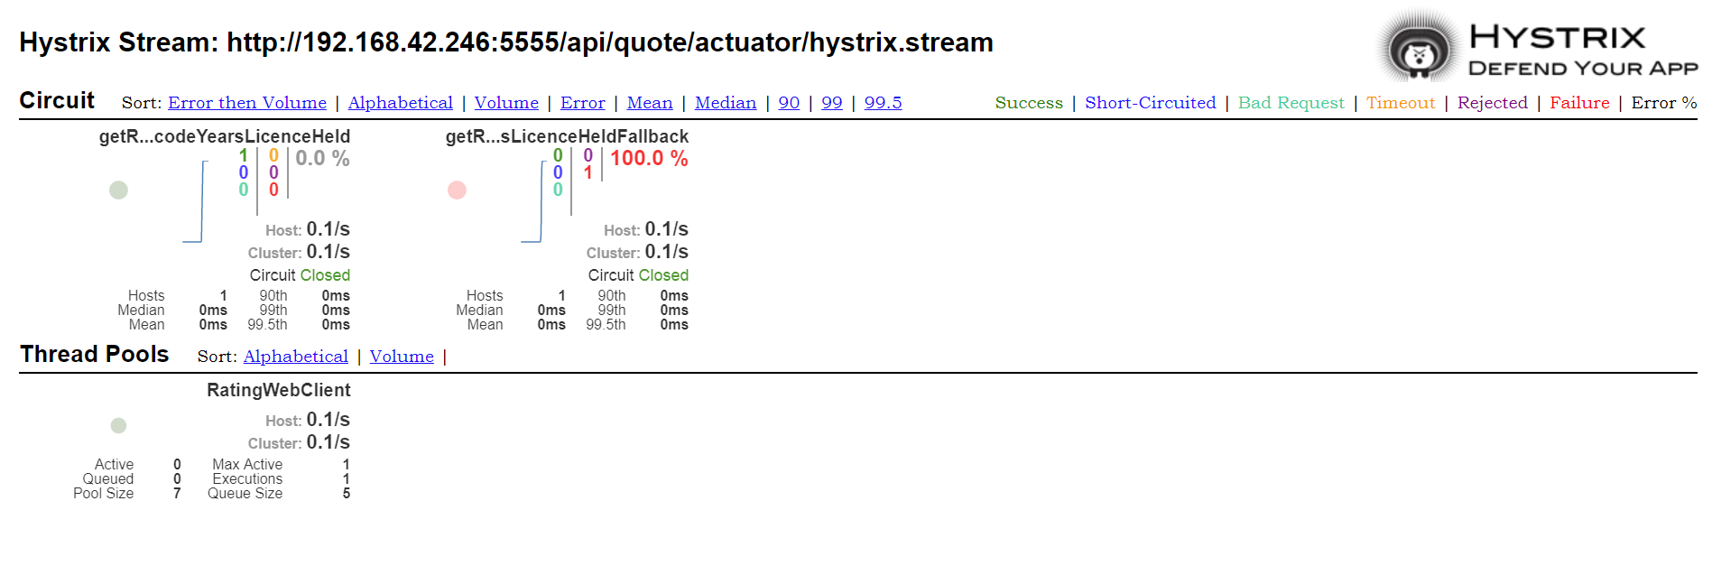

Slide 31
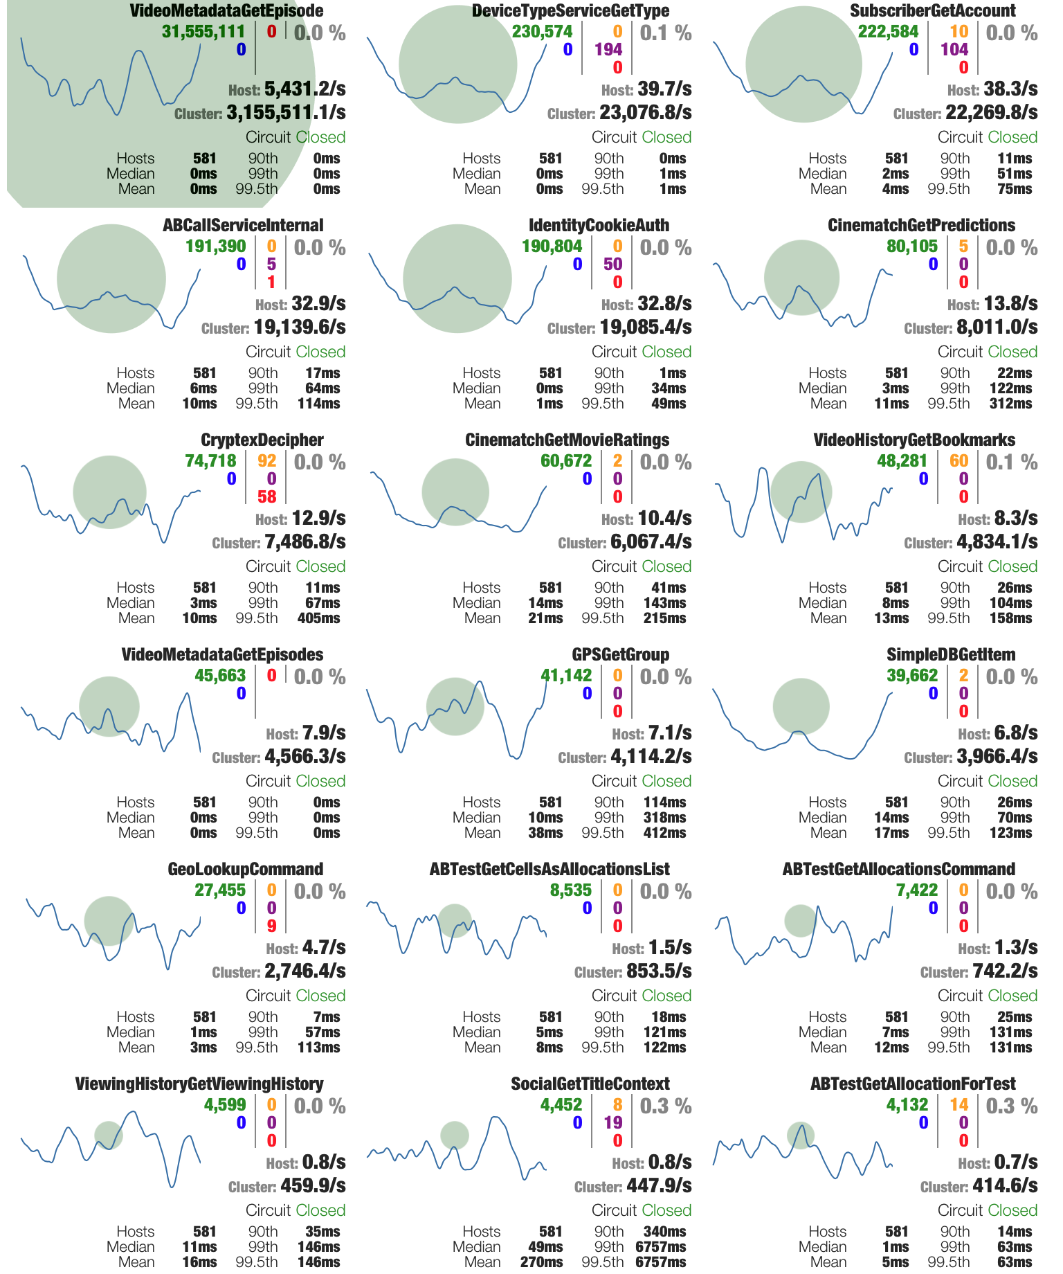
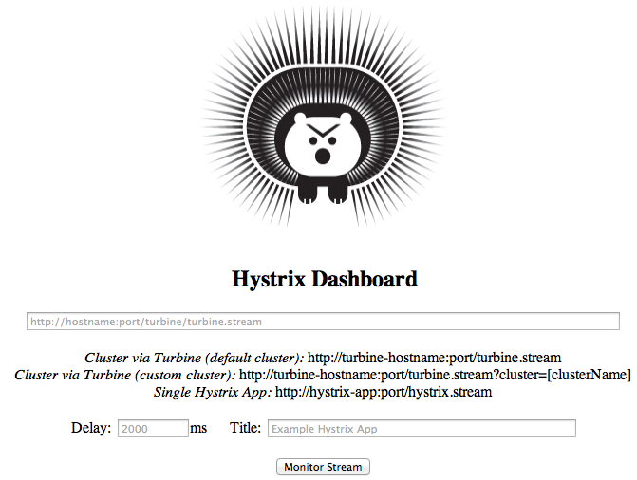
Hystrix Turbine
Source: Netflix API Hystrix Monitoring

Slide 32

- Authentication
- Stress Testing
- Canary Testing
- Dynamic Routing
- Service Migration
- Load Shedding
- Security
- Static response handling
- Traffic management
Zuul

Slide 33
Gateway – Netflix Zuul
Policy Enforcement Point (PEP) + Cross Cutting Concerns
Zuul will automatically use Eureka to look up and use Netflix Ribbon to do client-side load balancing of requests
Zuul Filters
Pre-Filter
Post-Filter
Route-Filter (Ex: A/B Testing)
Spring Cloud Gateway
Reactive non-blocking gateway

Slide 34
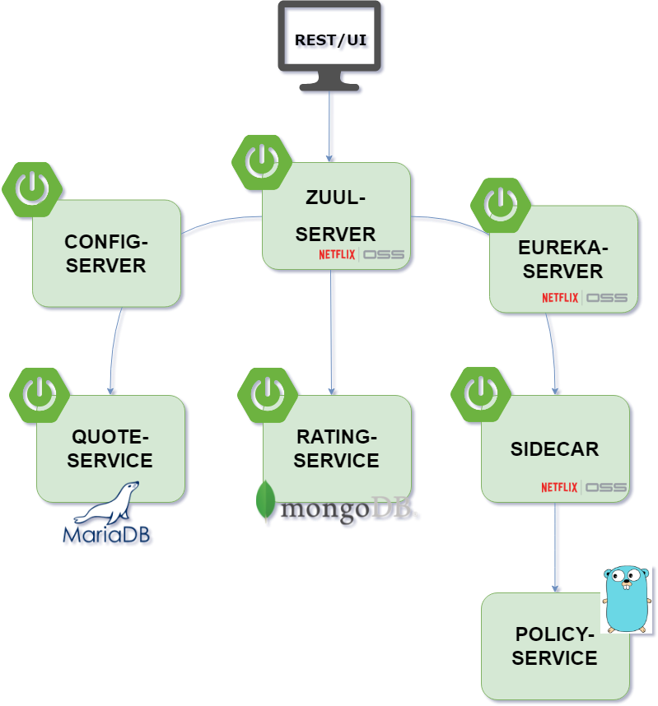

Slide 35

Polyglot Support - Netflix Sidecar
Based on Netflix Prana library
Non-JVM language services to harness other Netflix libraries
Embedded Zuul Proxy
@EnableSideCar
sidecar.health.uri => Accessible on Non-JVM apps for health status
Sidecar service should be run on the same host as the Non-JVM app

Slide 36
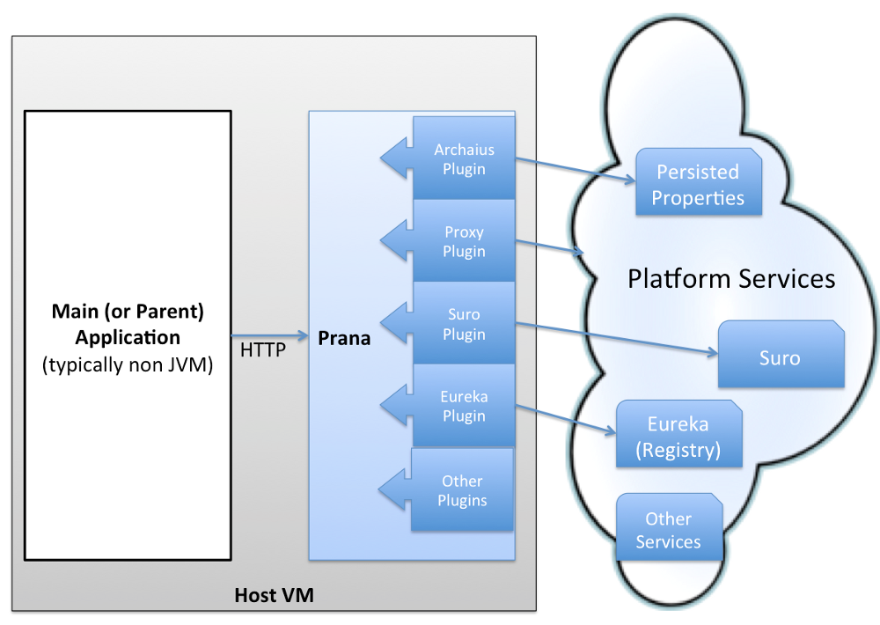
Sidecar Application
Source: Netflix blog

Slide 37
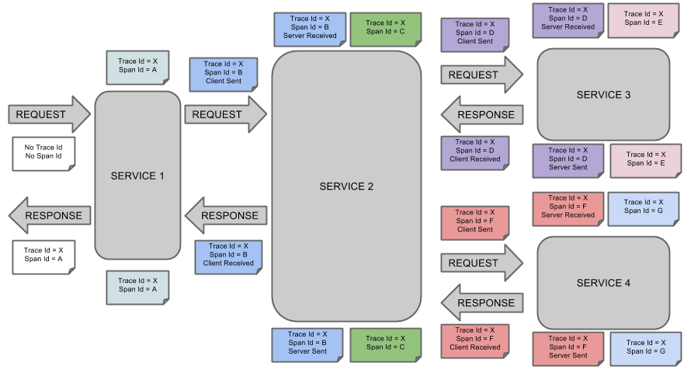
Logging/Tracing – Spring Cloud Sleuth
Source: https://cloud.spring.io/spring-cloud-sleuth/single/spring-cloud-sleuth.html

Slide 38
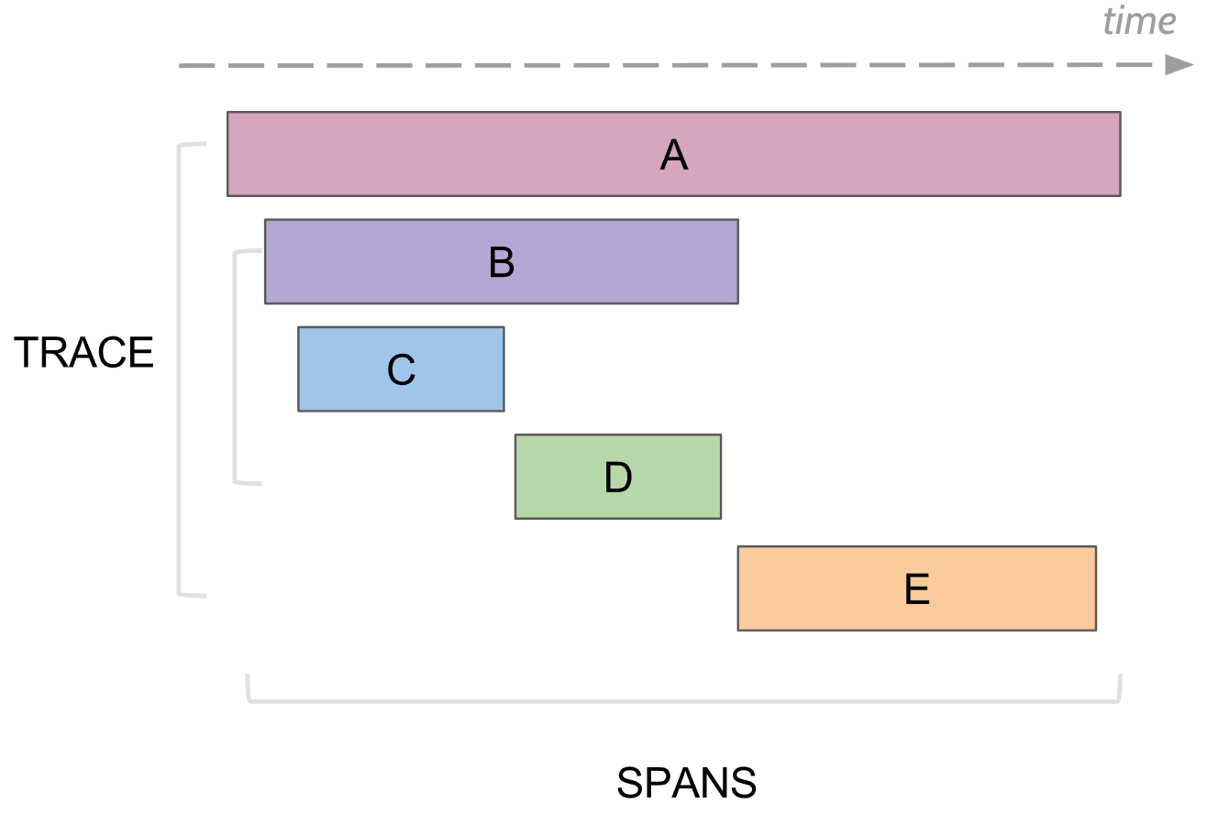
Logging/Tracing – Spring Cloud Sleuth

Slide 39
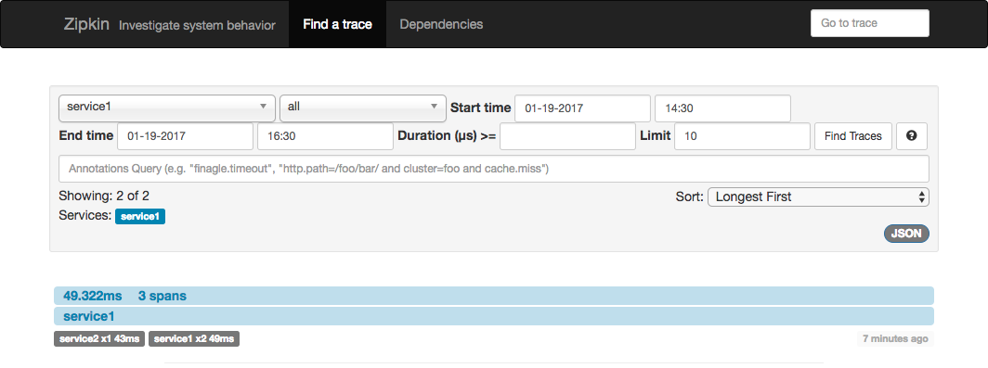
Logging/Tracing - Zipkin

Slide 40
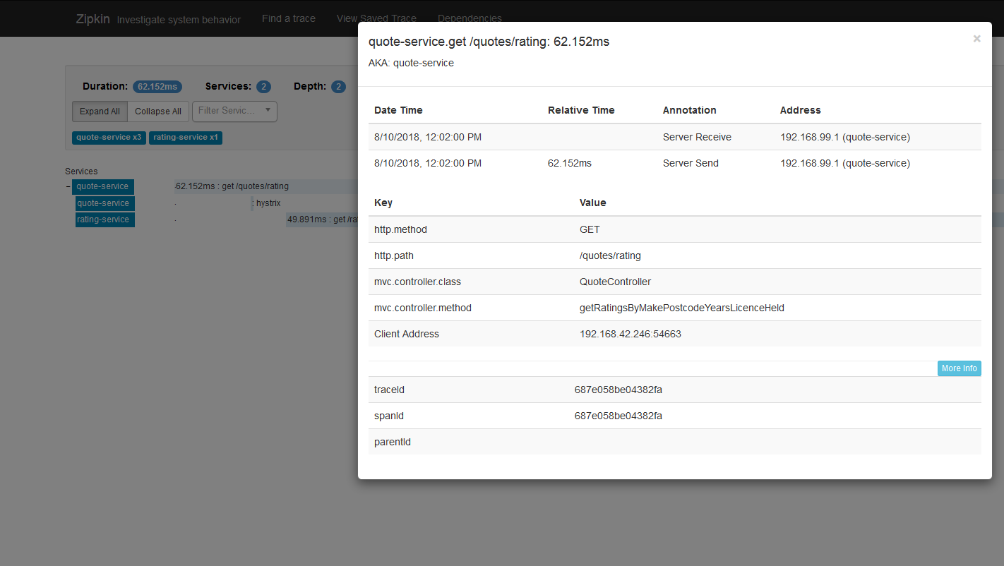

Slide 41
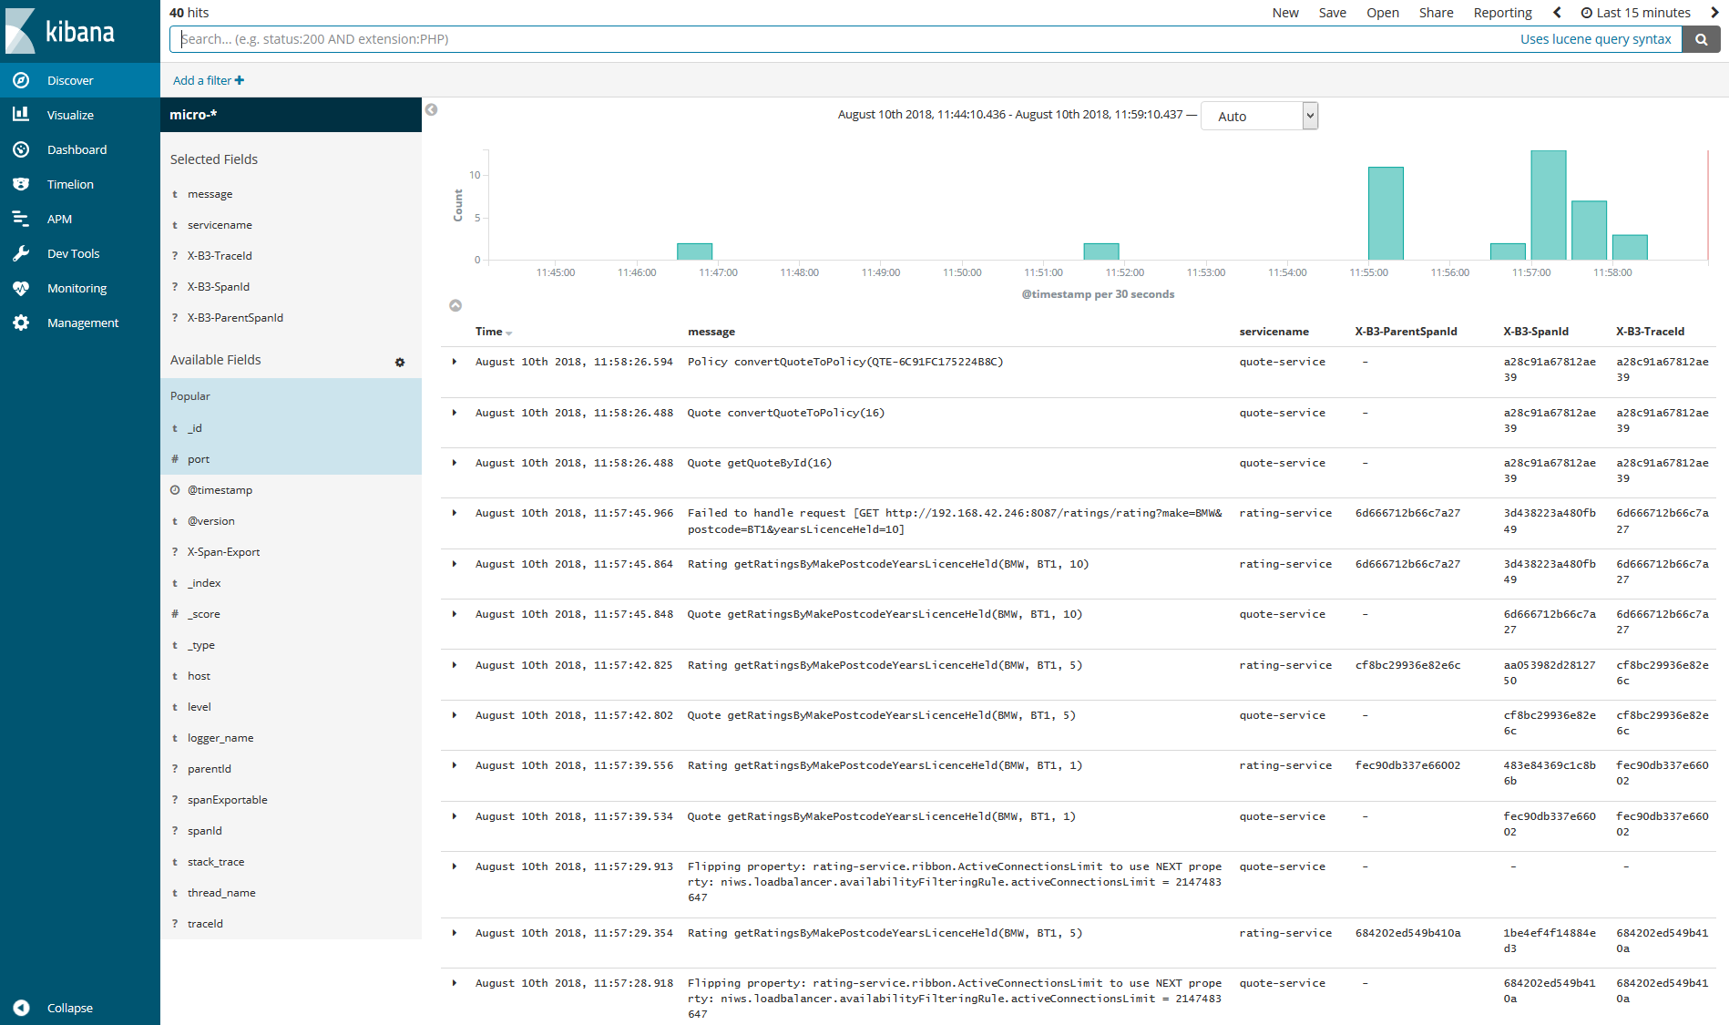

Slide 42
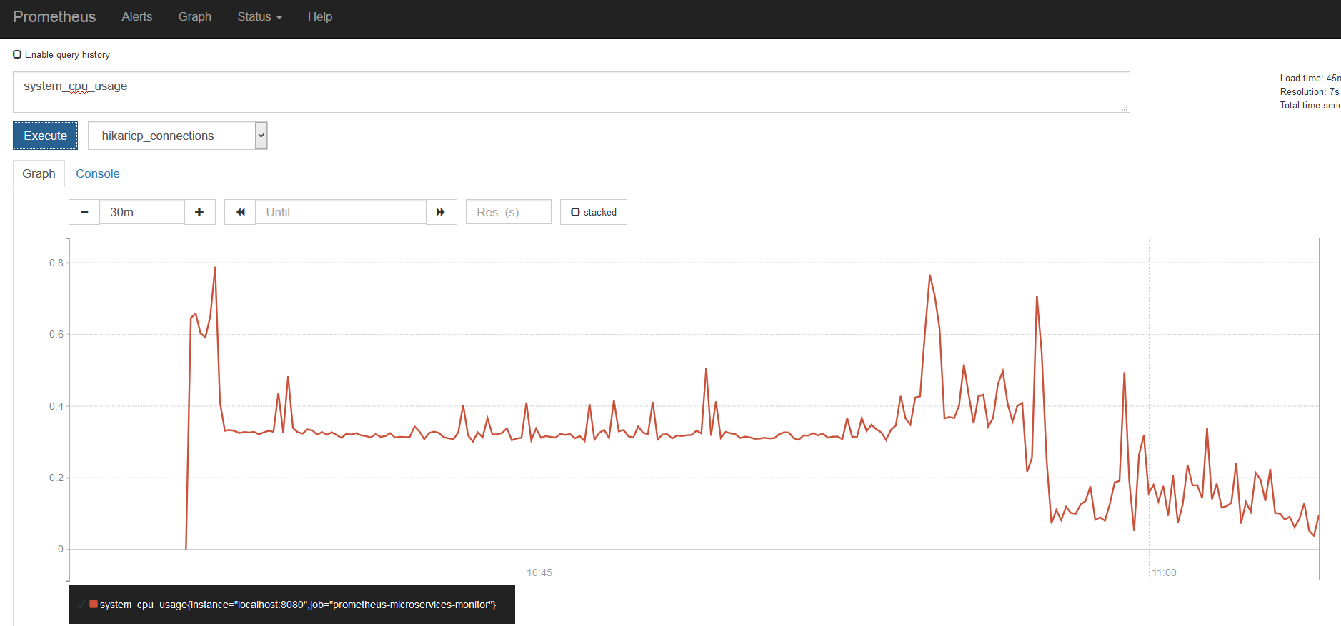

Slide 44
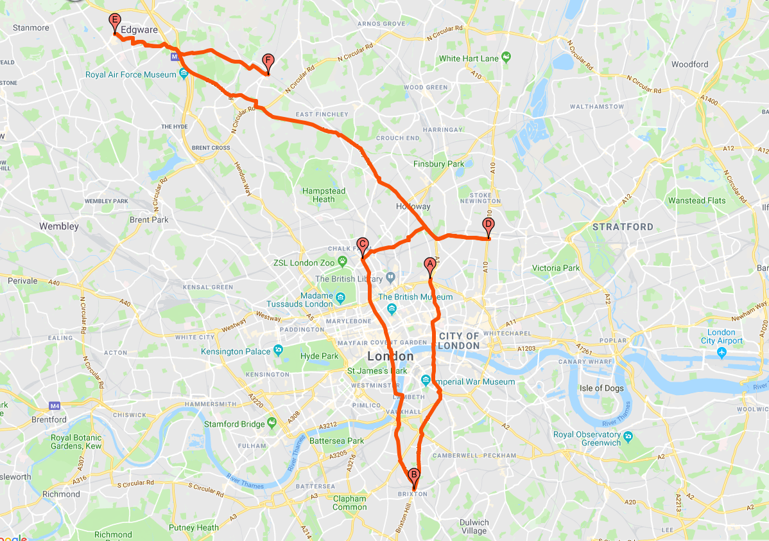
Release Train
Angel
Brixton
Camden
Dalston
Edgware
Finchley

Slide 45
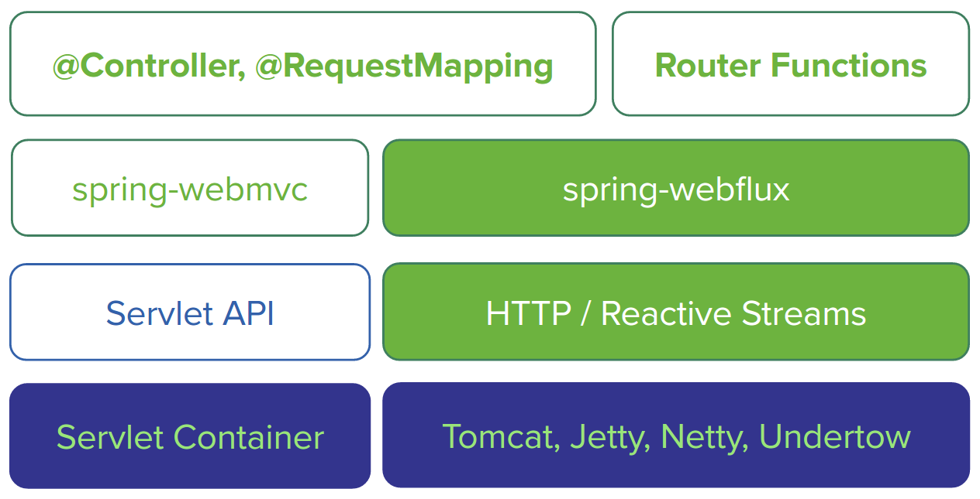
Source: cloud.spring.io

Slide 46
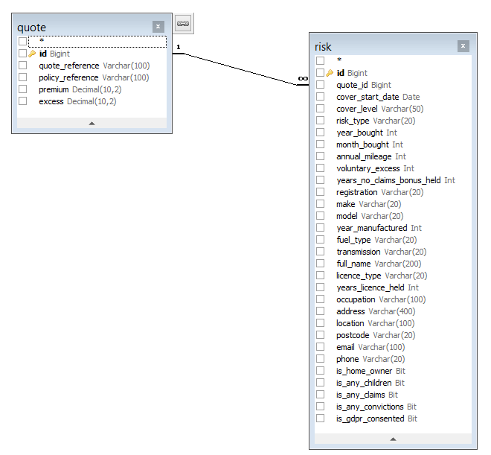
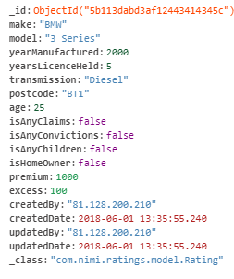
Risk
Rating
Quote

Slide 47
Quote Service
Rating Service
Policy Service
createQuote – POST
convertQuoteToPolicy – PATCH
GET
quotes
/quotes/id/{?}
/quotes//quote-reference/{?}
/quotes/convert/
/quotes/rating/
createRating – POST
Convert Quote to Policy – PATCH
GET
ratings
ratings/rating
ratings/ /make/{?}/model/{?}
/health
/convert

Slide 48
References
https://cloud.spring.io
https://martinfowler.com/articles/microservices.html
microservices.io
Spring in Action by John Carnell ISBN#9781617293986
YouTube videos – Josh Long, TechPrimers and many others

Slide 49
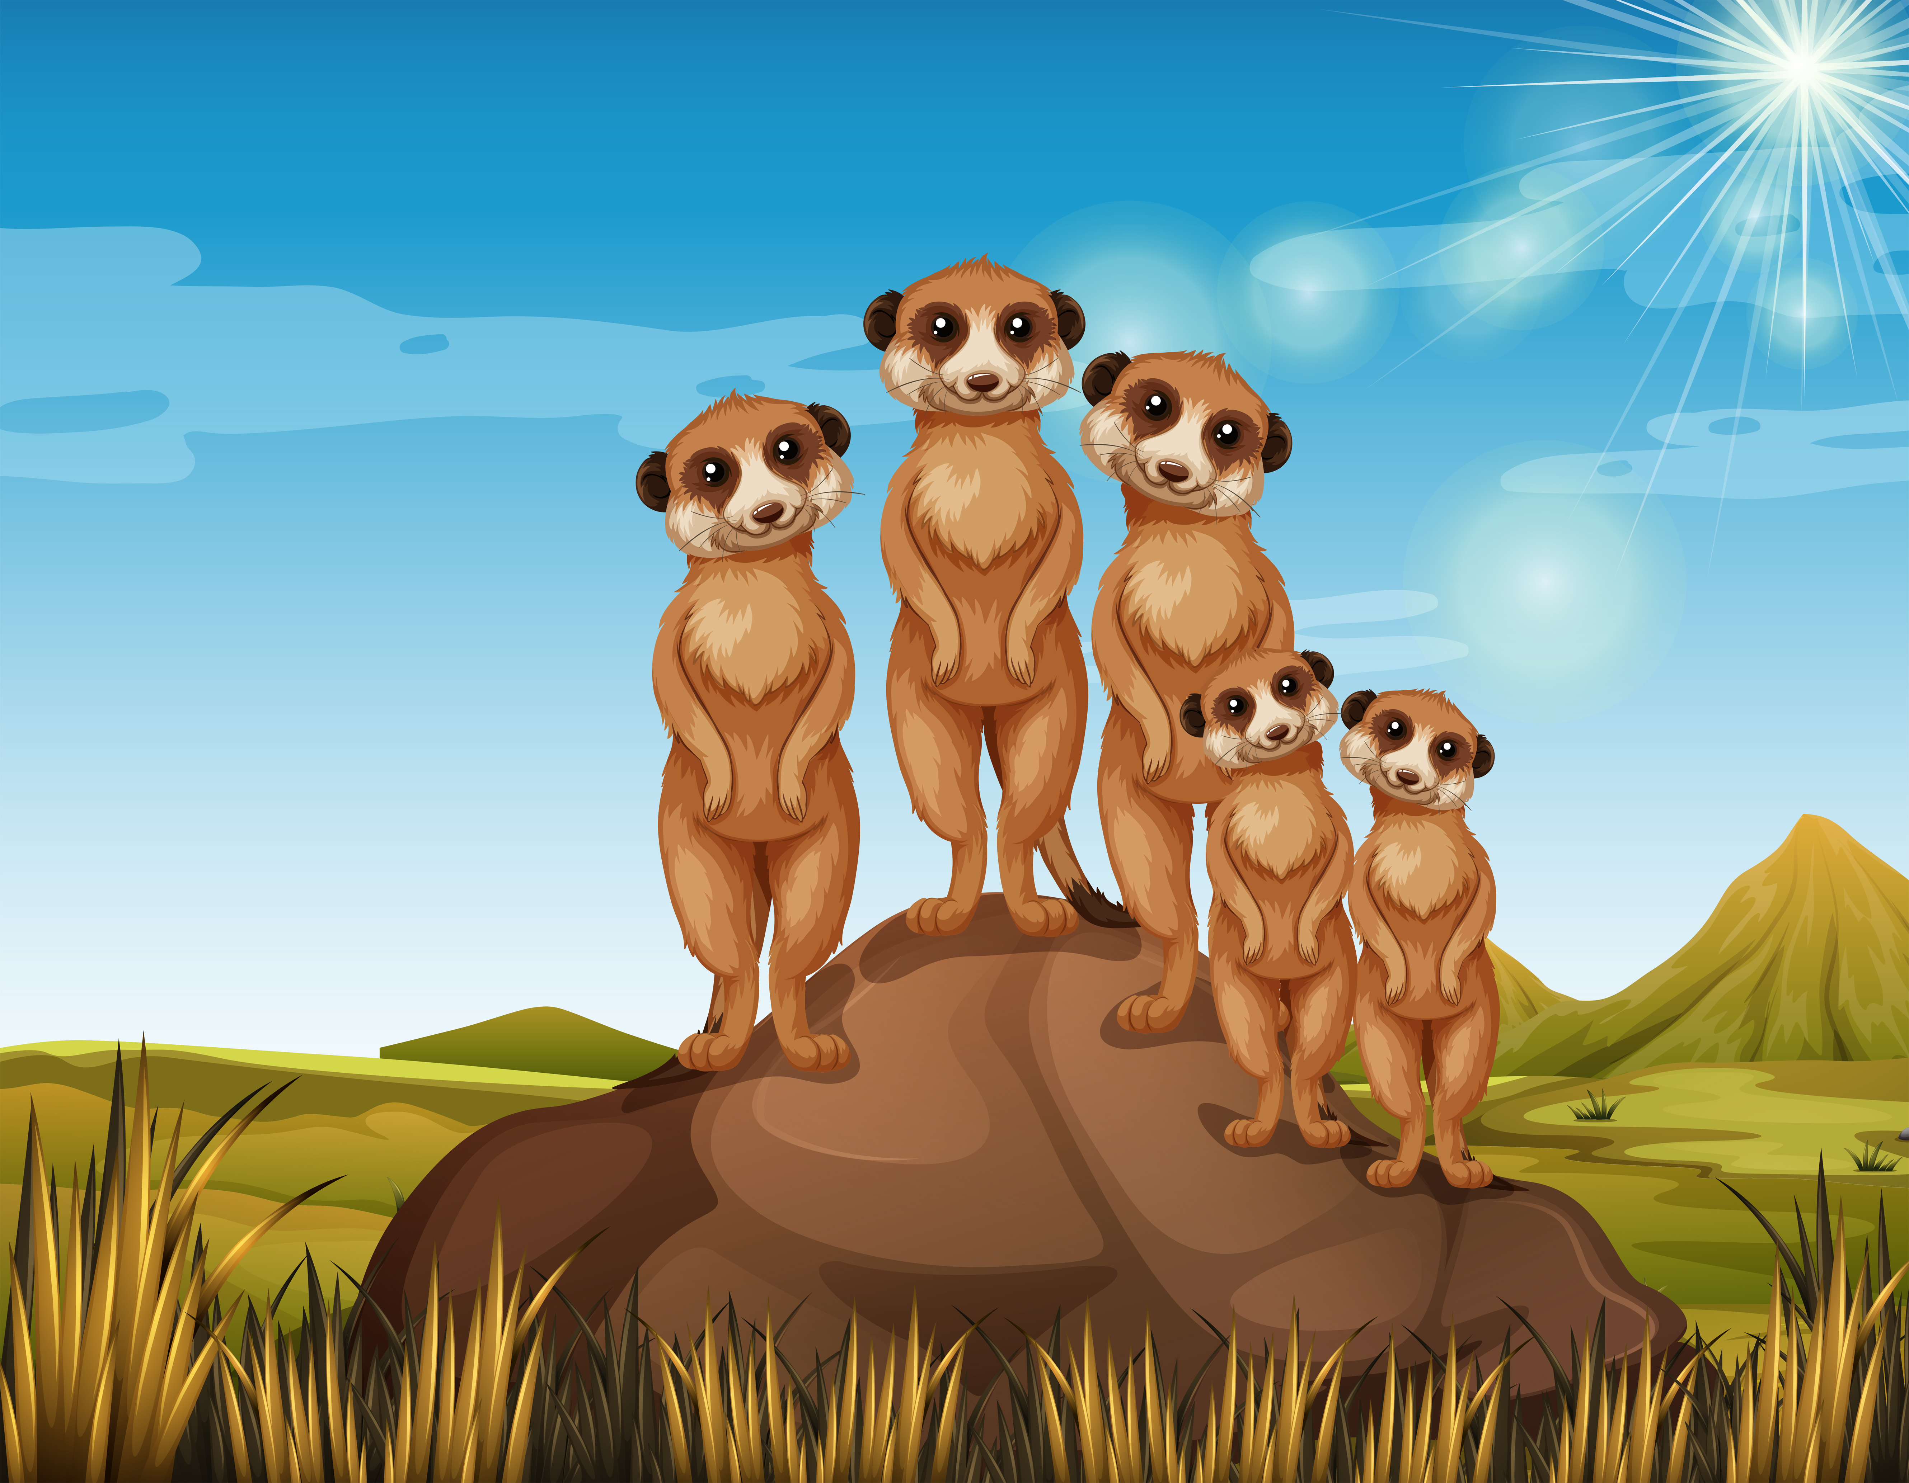
THANK
YOU
Questions?
@udhayapps
udhayapps@gmail.com

